Slide 1
Java Most Imp. Interview Questions
Singleton class with & without thread
Hashmap Vs hashtable
String mutable & immutable
String buffer & builder
Mutable class
Java threads & latches
Hashmap internal design using bucketing
8. Annotations

Slide 2
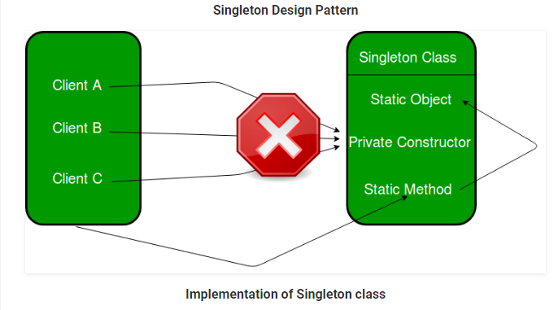
Singleton Design Pattern | Introduction
Singleton is a part of Gang of Four design pattern and it is categorized under creational design patterns It is one of the most simple design patterns in terms of the modelling but on the other hand, this is one of the most controversial patterns in terms of complexity of usage.
Class is defined in such a way that only one instance of the class is created in the complete execution of a program or project. It is used where only a single instance of a class is required to control the action throughout the execution. A singleton class shouldn’t have multiple instances in any case and at any cost. Singleton classes are used for logging, driver objects, caching and thread pool, database connections.
Definition: The singleton pattern is a design pattern that restricts the instantiation of a class to one object.

Slide 3
Implementation of Singleton class
An implementation of singleton class should have following properties:
It should have only one instance : This is done by providing an instance of the class from within the class. Outer classes or subclasses should be prevented to create the instance. This is done by making the constructor private in java so that no class can access the constructor and hence cannot instantiate it.
Instance should be globally accessible : Instance of singleton class should be globally accessible so that each class can use it. In Java, it is done by making the access-specifier of instance public.
filter_none
//A singleton class should have public visibility
//so that complete application can use
public class GFG {
//static instance of class globally accessible
public static GFG instance = new GFG();
private GFG() {
// private constructor so that class
//cannot be instantiated from outside
//this class
}
}

Slide 4
Initialization Types of Singleton
Singleton class can be instantiated by two methods:Early initialization : In this method, class is initialized whether it is to be used or not. The main advantage of this method is its simplicity. You initiate the class at the time of class loading. Its drawback is that class is always initialized whether it is being used or not.
Lazy initialization : In this method, class in initialized only when it is required. It can save you from instantiating the class when you don’t need it. Generally, lazy initialization is used when we create a singleton class.
Sometimes we need to have only one instance of our class for example a single DB connection shared by multiple objects as creating a separate DB connection for every object may be costly. Similarly, there can be a single configuration manager or error manager in an application that handles all problems instead of creating multiple managers.

Slide 5
Examples of Singleton class
java.lang.Runtime : Java provides a class Runtime in its lang package which is singleton in nature. Every Java application has a single instance of class Runtime that allows the application to interface with the environment in which the application is running. The current runtime can be obtained from the getRuntime() method. An application cannot instantiate this class so multiple objects can’t be created for this class. Hence Runtime is a singleton class.
java.awt.Desktop : The Desktop class allows a Java application to launch associated applications registered on the native desktop to handle a URI or a file. Supported operations include:
launching the user-default browser to show a specified URI; launching the user-default mail client with an optional mailto URI;
launching a registered application to open, edit or print a specified file.
This class provides methods corresponding to these operations. The methods look for the associated application registered on the current platform, and launch it to handle a URI or file. If there is no associated application or the associated application fails to be launched, an exception is thrown.
Each operation is an action type represented by the Desktop.Action class.
This class also cannot be instantiated from application. Hence it is also a singleton class.

Slide 6
Applications of Singleton classes
There is a lot of applications of singleton pattern like cache-memory, database connection, drivers, logging. Some major of them are :-
Logger : Singleton classes are used in log file generations. Log files are created by the logger class object. Suppose an application where the logging utility has to produce one log file based on the messages received from the users. If there is multiple client application using this logging utility class they might create multiple instances of this class and it can potentially cause issues during concurrent access to the same logger file. We can use the logger utility class as a singleton and provide a global point of reference so that each user can use this utility and no 2 users access it at the same time.
Configuration File: This is another potential candidate for Singleton pattern because this has a performance benefit as it prevents multiple users to repeatedly access and read the configuration file or properties file. It creates a single instance of the configuration file which can be accessed by multiple calls concurrently as it will provide static config data loaded into in-memory objects. The application only reads from the configuration file for the first time and thereafter from second call onwards the client applications read the data from in-memory objects.
Cache: We can use the cache as a singleton object as it can have a global point of reference and for all future calls to the cache object the client application will use the in-memory object.

Slide 7
Important points
Singleton classes can have only one instance and that instance should be globally accessible.
java.lang.Runtime and java.awt.Desktop are 2 singleton classes provided by JVM.
Singleton Design pattern is a type of creational design pattern.
Outer classes should be prevented to create instance of singleton class

Slide 8
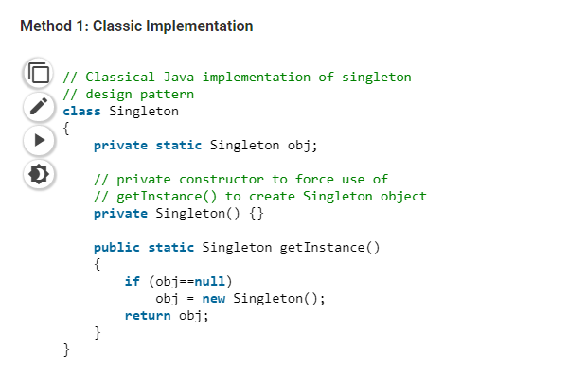
Implementing Singleton class with & without thread
Let’s see various design options for implementing such a class. If you have a good handle on static class variables and access modifiers this should not be a difficult task.

Slide 9
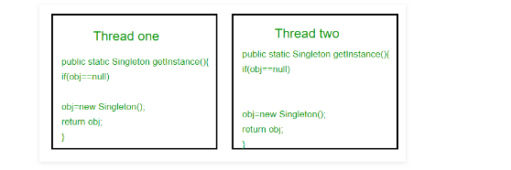
Here we have declared getInstance() static so that we can call it without instantiating the class. The first time getInstance() is called it creates a new singleton object and after that it just returns the same object. Note that Singleton obj is not created until we need it and call getInstance() method. This is called lazy instantiation.
The main problem with above method is that it is not thread safe. Consider the following execution sequence.
This execution sequence creates two objects for singleton. Therefore this classic implementation is not thread safe.

Slide 10
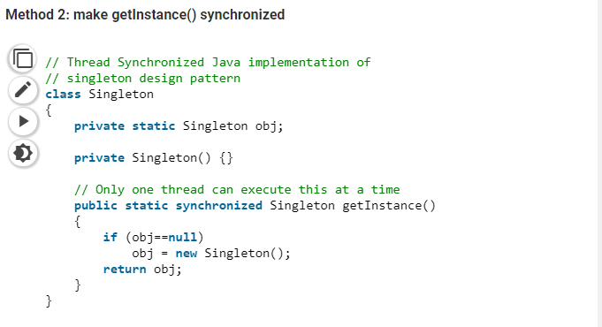
Here using synchronized makes sure that only one thread at a time can execute getInstance(). The main disadvantage of this is method is that using synchronized every time while creating the singleton object is expensive and may decrease the performance of your program. However if performance of getInstance() is not critical for your application this method provides a clean and simple solution.

Slide 11
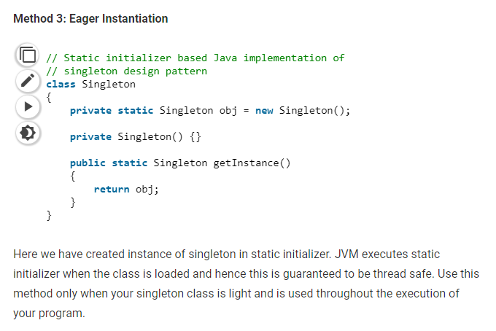

Slide 12
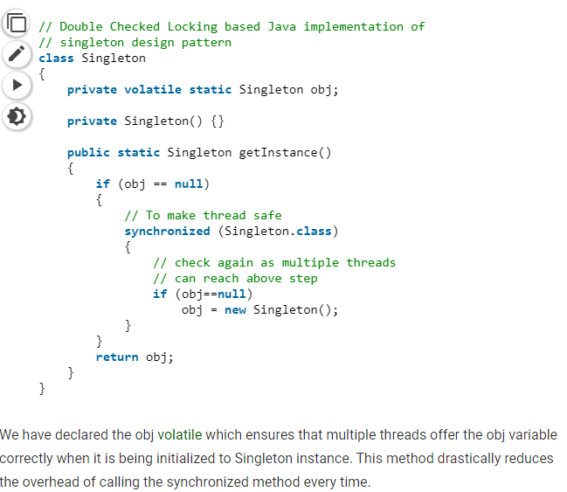
Method 4 (Best): Use “Double Checked Locking” If you notice carefully once an object is created synchronization is no longer useful because now obj will not be null and any sequence of operations will lead to consistent results. So we will only acquire lock on the getInstance() once, when the obj is null. This way we only synchronize the first way through, just what we want.

Slide 13
2. Hashmap vs Hashtable
1. HashMap is non synchronized. It is not-thread safe and can’t be shared between many threads without proper synchronization code whereas Hashtable is synchronized. It is thread-safe and can be shared with many threads.
(Synchronous basically means that you can only execute one thing at a time. Asynchronous means that you can execute multiple things at a time and you don't have to finish executing the current thing in order to move on to next one.)
2. HashMap allows one null key and multiple null values whereas Hashtable doesn’t allow any null key or value. 3. HashMap is generally preferred over HashTable if thread synchronization is not needed
Why HashTable doesn’t allow null and HashMap does? To successfully store and retrieve objects from a HashTable, the objects used as keys must implement the hashCode method and the equals method. Since null is not an object, it can’t implement these methods. HashMap is an advanced version and improvement on the Hashtable. HashMap was created later.

Slide 14
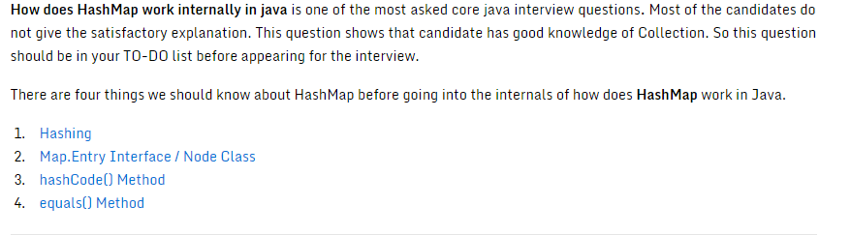
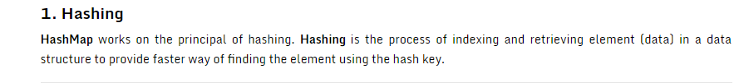

Slide 15
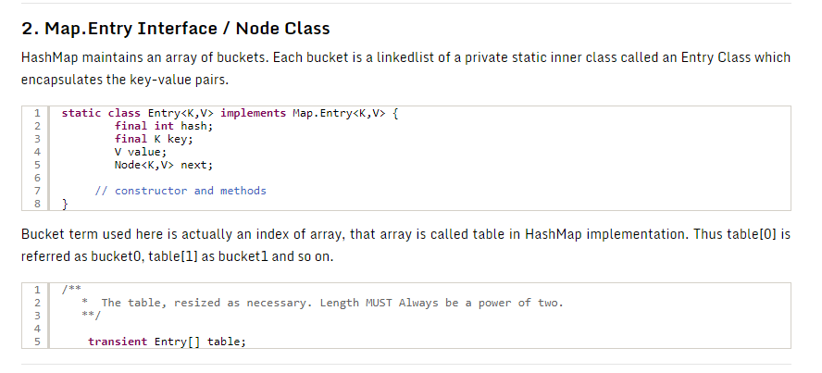

Slide 16
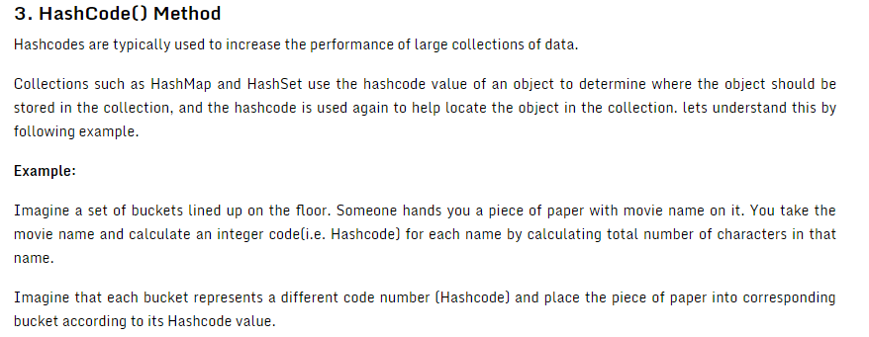
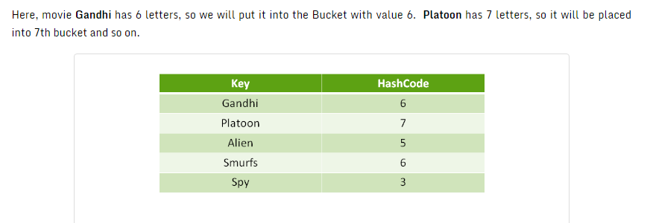

Slide 17
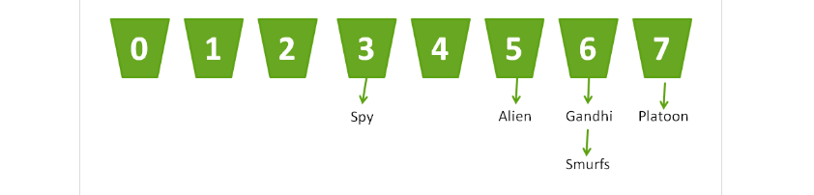
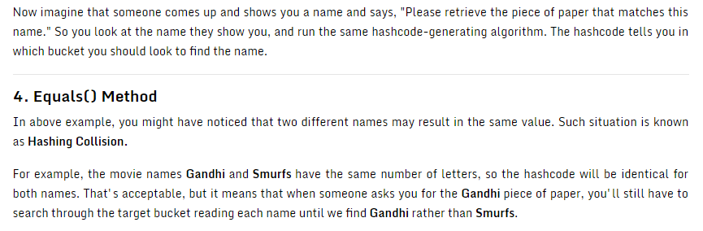

Slide 18
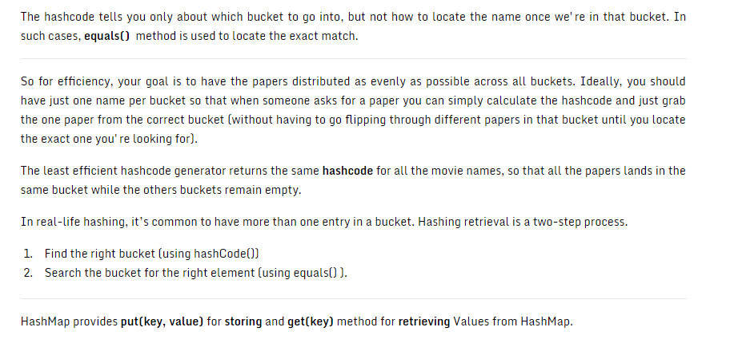

Slide 19
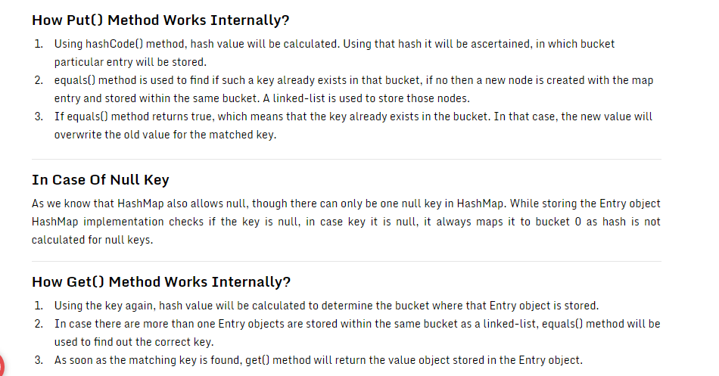

Slide 20
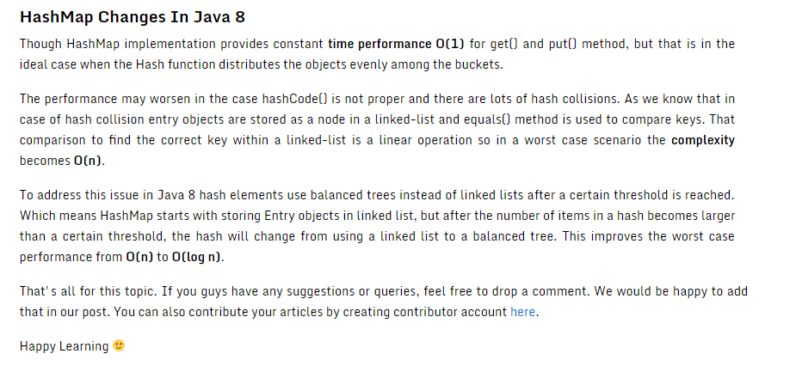

Slide 21
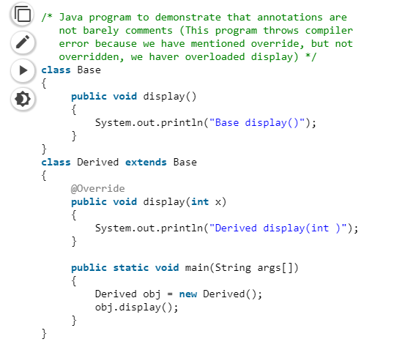
Annotations(a note by way of explanation or comment added to a text or diagram) in Java
Annotations are used to provide supplement information about a program.
Annotations start with ‘@’.
Annotations do not change action of a compiled program.
Annotations help to associate metadata (information) to the program elements i.e. instance variables, constructors, methods, classes, etc.
Annotations are not pure comments as they can change the way a program is treated by compiler. See below code for example.

Slide 22
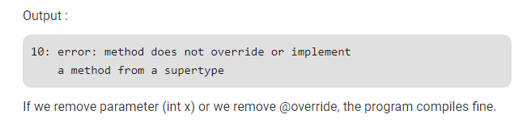
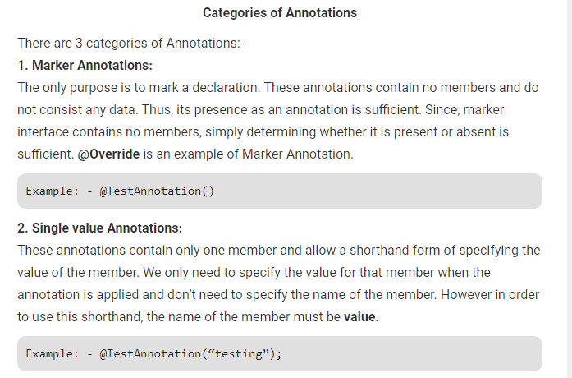

Slide 23

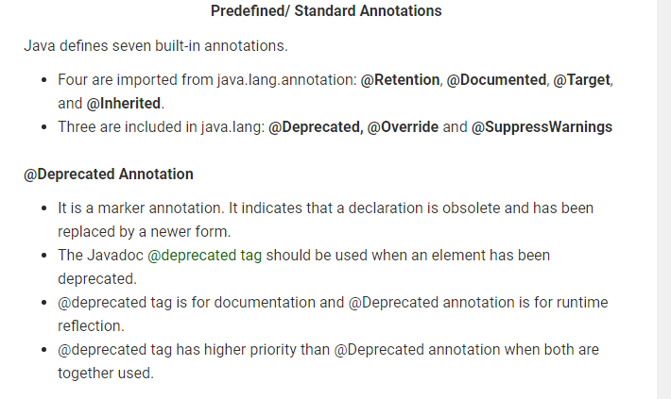

Slide 24
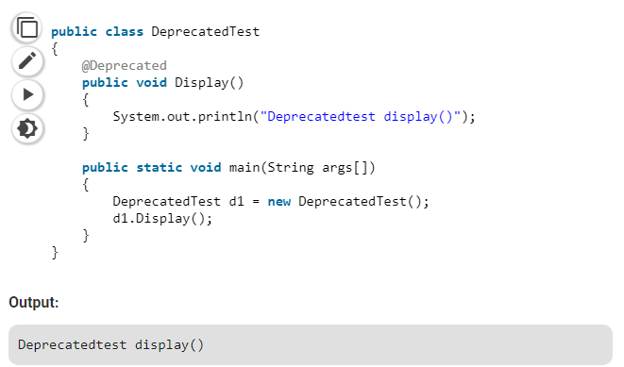
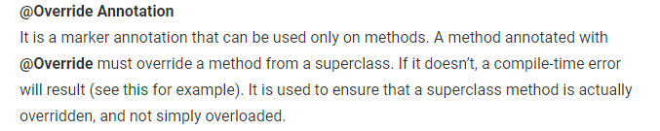

Slide 25
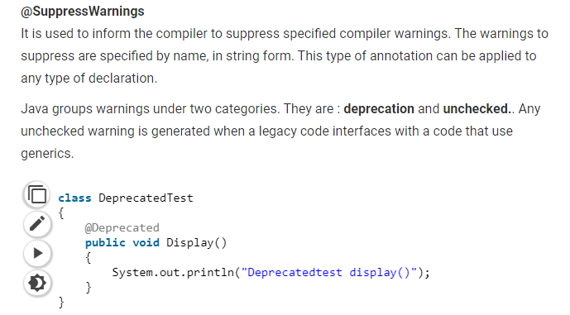
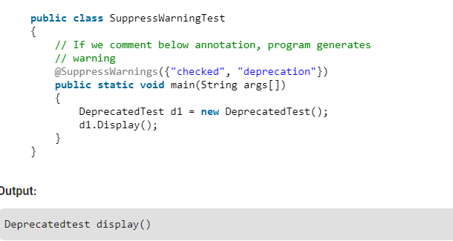

Slide 26
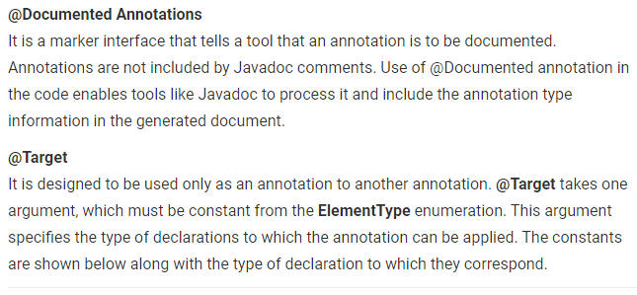
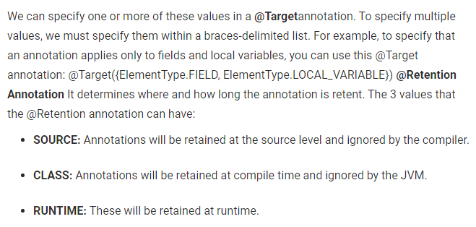

Slide 27
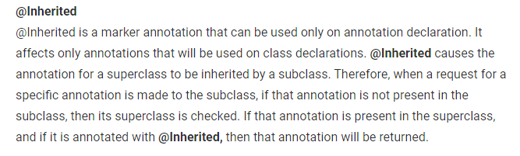
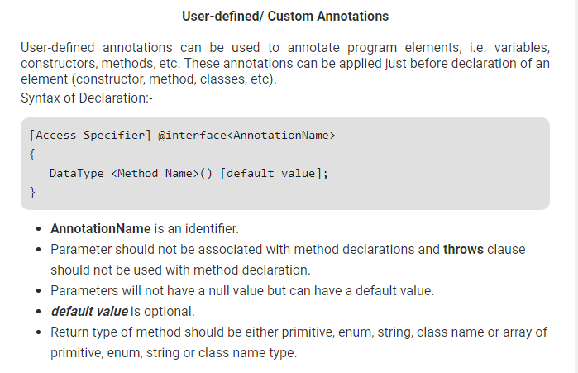

Slide 28
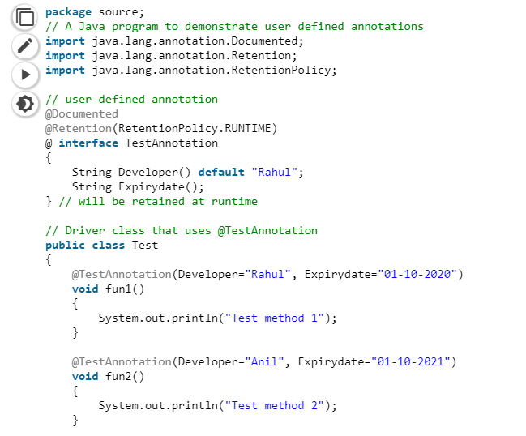
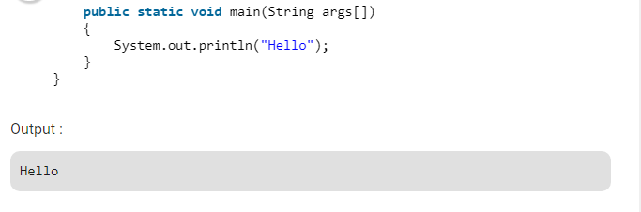

Slide 29
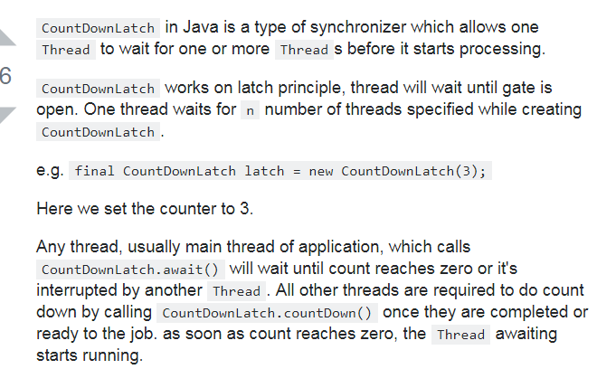
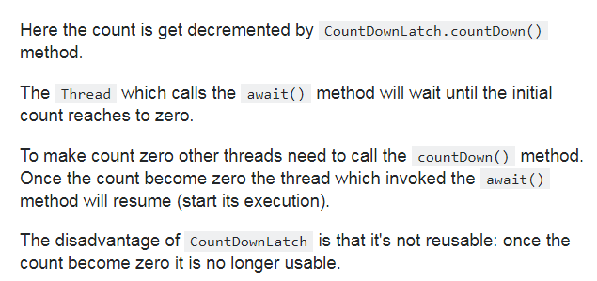

Slide 30
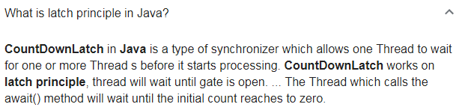

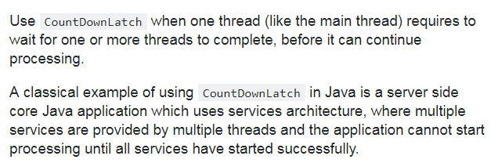

Slide 31
CountDownLatch in Java
CountDownLatch is used to make sure that a task waits for other threads before it starts. To understand its application, let us consider a server where the main task can only start when all the required services have started.
Working of CountDownLatch: When we create an object of CountDownLatch, we specify the number of threads it should wait for, all such thread are required to do count down by calling CountDownLatch.countDown() once they are completed or ready to the job. As soon as count reaches zero, the waiting task starts running.

Slide 32
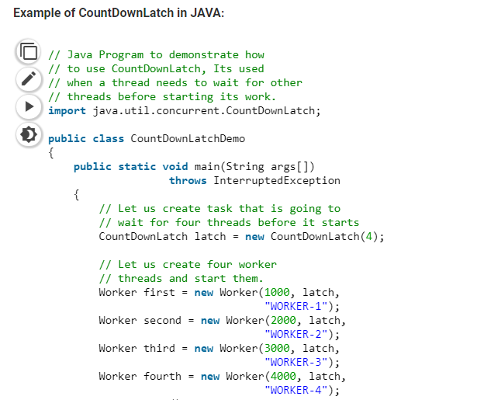
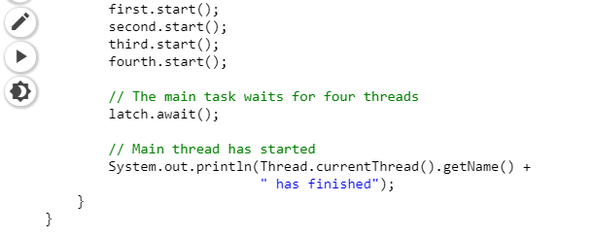

Slide 33
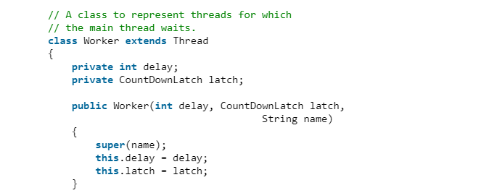
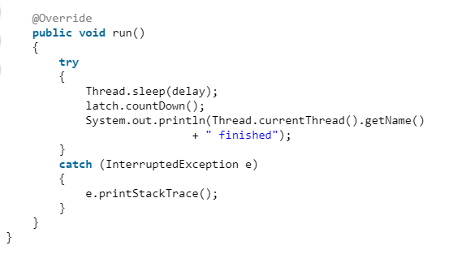

Slide 34
